Slide 1
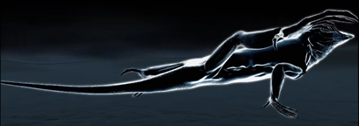
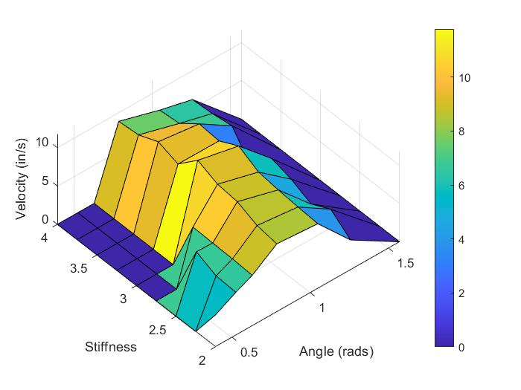
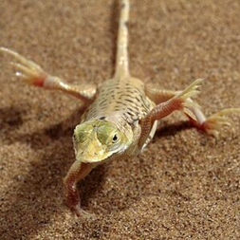
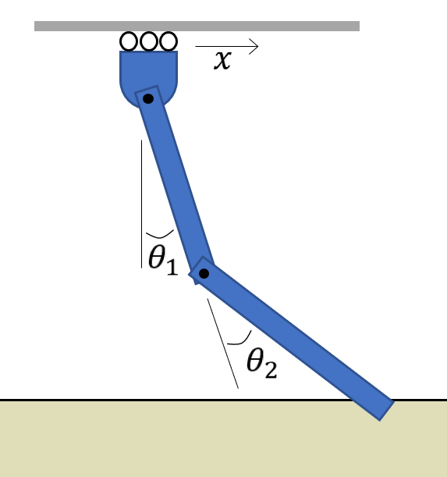
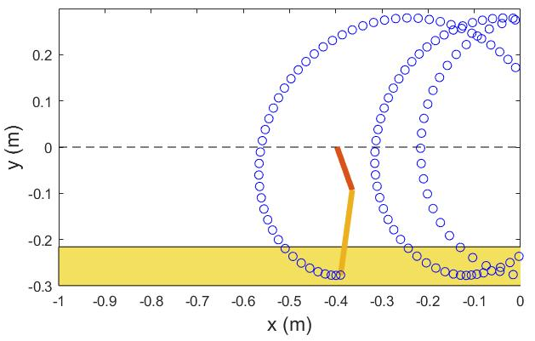
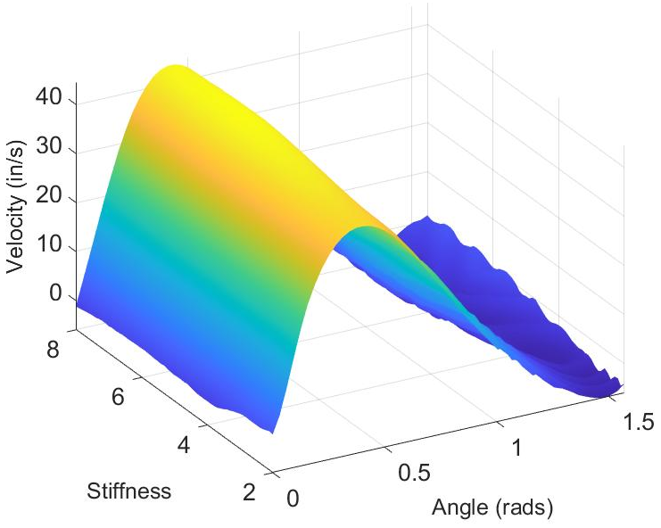
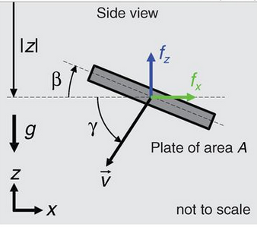
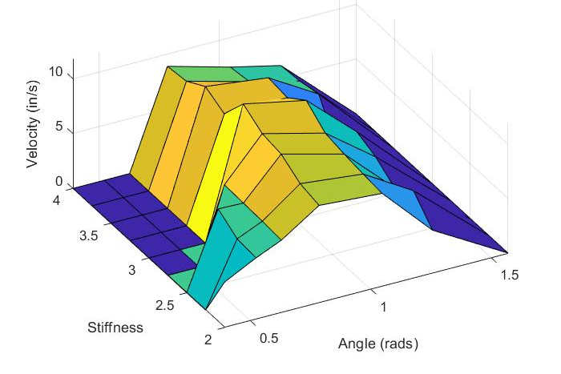
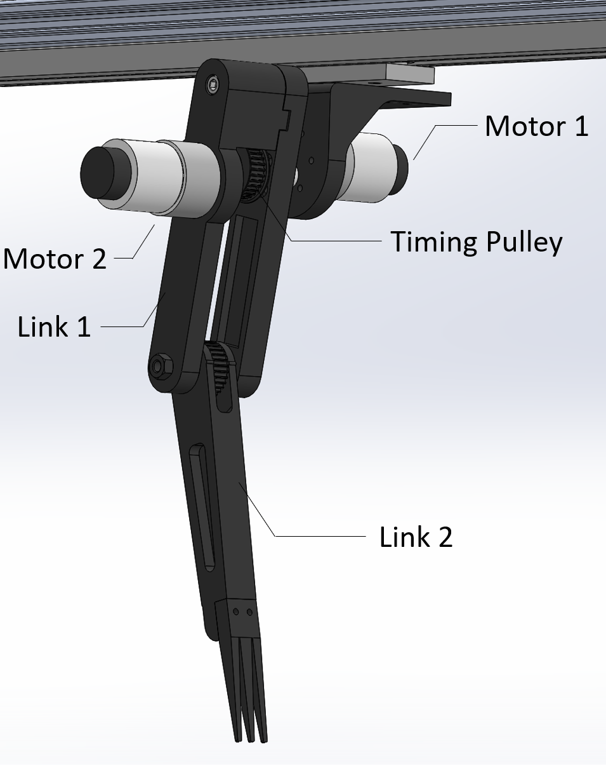
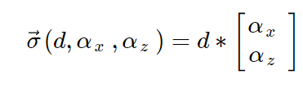
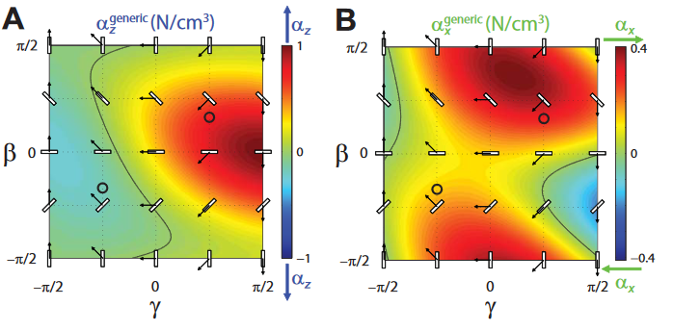
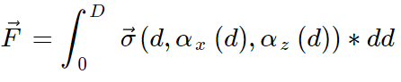
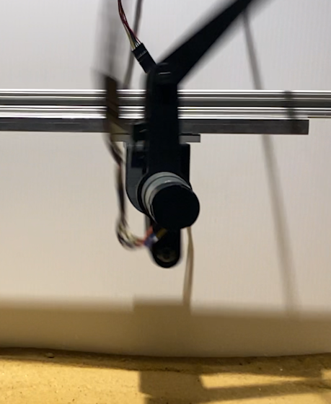
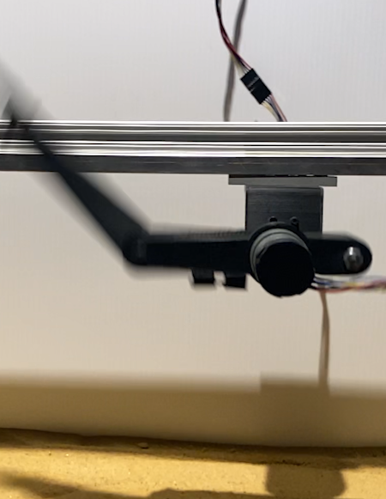
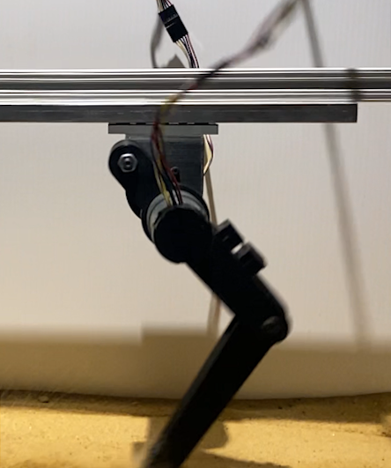
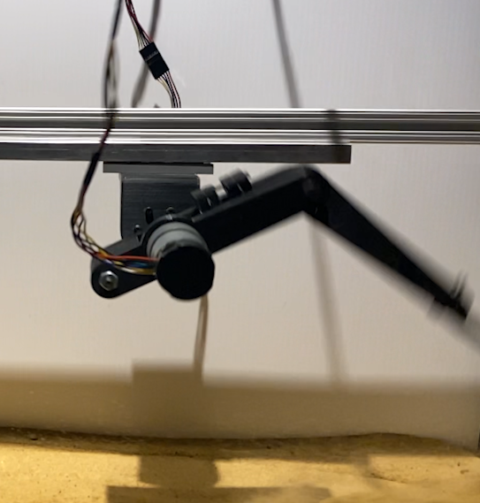
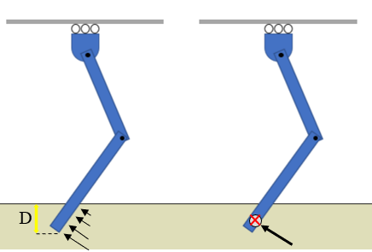

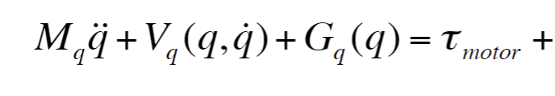

Maximizing Speed for Sand Locomotion using Lizard-Inspired Leg
Team Names: Jose Martinez, Ruben Castro, Nisal Ovitigala, Melissa Klein
Introduction
Simulation Results
Experimental Results
For humans, running in the sand requires 1.6 times more energy expenditure than running on a hard surface ¹
Shovel-Snouted Lizards move paddle-like back feet in a 360 degree trajectory, being able to reach speeds of about 3 feet/sec, which is over 20 times its body length ²
The simulation incorporated the sand model into its dynamics and was run on a forward Euler algorithm. To control the leg, the first joint was driven with the maximum torque the motor can produce while following its torque-speed curve. The second joint was driven using a PD impedance controller to hold a fixed angle. The simulation was run to find the optimal stiffness value and leg angle for the second joint.
Optimal joint angle: ~π/4 rad
Optimal stiffness: 3.0
Drop-off in speed due to lower foot engagement with sand
Optimal joint angle: 0.41 rad
Optimal stiffness: 5.6
Stiffness has minimal impact on the average velocity
Using impedance control on a 2-DOF robotic leg, the “paddle” locomotion strategy is replicated, with the hip joint having 360 degree range of motion.
This project aims to explore an optimal 2nd joint angle 𝛉₂ and stiffness that leads to a highest average speed of locomotion when utilizing this locomotion strategy.
Drop-off in speed due to locking behavior
Discussion
Simulation
Sand Modeling
Qualitatively, both experimental and simulation results display a concave contour with a clear maximum angle.
Maximum velocity in simulation is ~3.8x greater than in experiment
Disparity in values may be due to:
Differences in granularities of sand
Friction in experimental setup
Linear slide locking & motor torque limit
Determine β and γ: Attack & Intrusion angles
Compute 𝛼 values in x and z directions from Dan Goldman generic model ³
Determine stress ( 𝛼 * depth)
Find center of pressure (COP)
Sum stresses
Compute generalized forces from transpose of Jacobian at COP
Add into dynamics
Experimental Methods
Experiment
2-DOF robotic leg with concentric motors for:
Full range of motion at hip joint
Low leg inertia for hip motor to actuate
Used linear slide gantry to support leg weight and allow for motion in X axis. Ran all experiments using 100% duty cycle on hip motor and varying input stiffnesses and angles for second joint. Slow motion video captured for all runs, and frame count used to measure average velocity over track length.
Conclusion
There exists an optimal setpoint angle for joint impedance control during sand locomotion
Experiment: ~𝜋/4, Simulation:~ 𝜋/8
Minimal correlation between 2nd joint stiffness & maximum velocity
Cartesian control & trajectory optimization challenging with current setup
Variability in sand medium presents uncertainty in simulation
References
Lejeune, T.M. "Mechanics and Energetics of Human Locomotion on Sand." Journal of Experimental Biology (1998): 10.
Smithsonian. “Speed Kills: Desert.” 19 May 2015. Video.
Goldman, Li, & Zhang. “A Terradynamics of Legged Locomotion on Granular Media.” Science (2013)
COP
We would like to thank the course staff for their guidance and endless support throughout this semester!

